Slide 1

Welcome to the School of Nursing,
Midwifery and Health Systems
Fáilte go dtí Scoil na hAltrachta, an Chnáimhseachais agus na gCóras Sláinte UCD
Undergraduate Orientation Day | Wednesday 03 September 2025

Slide 2

Overview
The School Office
Registration
SISWeb
Student Desk
UCARD
Orientation timetable Thursday 04 September
Parking on Campus
Undergraduate Orientation Day | Wednesday 03 September 2025

Slide 3
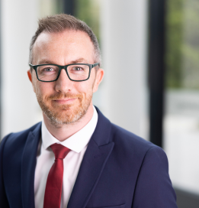
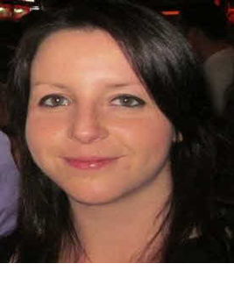
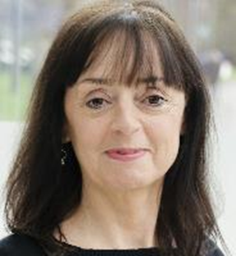
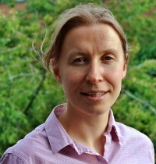
Undergraduate School Office
Who we are
School Director, James Hayes | B1.05/06 |  | SNMHS contact form
Programmes and Operations Manager, Fiona Lynch | B1.05/06 | 01 7166432 | SNMHS contact form
Programme Manager, Tina Saul | B1.05/06 | 01 7166569 | SNMHS contact form
Programme Administrator, Grainne Connor | B1.05/06 | 01 7166407 | SNMHS contact form
 |  |  | Faculty and Staff Contact Details
Opening Hours | Monday – Friday 09:30– 16:00 (also available via contact form)
www.nmhs.ucd.ie/contact-us

Slide 4
School Office
How we can support you
Your Programme administrator can help with any queries
Registration, Academic Regulations, Extenuating Circumstances, Leave of Absence, Recognition of Prior Learning
Please contact us. If we can’t help, we’ll put you in contact with someone who can
www.nmhs.ucd.ie/contact-us

Slide 5

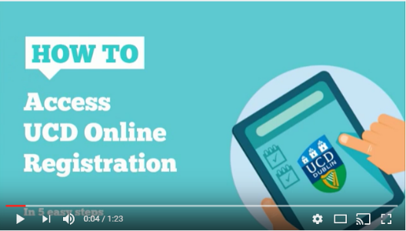
Registration
What you need to know
Lots of information online
Registration Guides
SNMHS contact form
Registration closes Friday 19 September 2025, 5pm
– so make sure you complete your registration
Key dates
www.ucd.ie/students/registration

Slide 6

Registration
What you need to do
Complete Programme Requirements
60 ECTS credits for Stage 1
Select Labs/practicals/tutorials
No elective modules required in stage 1
www.ucd.ie/students/registration

Slide 7
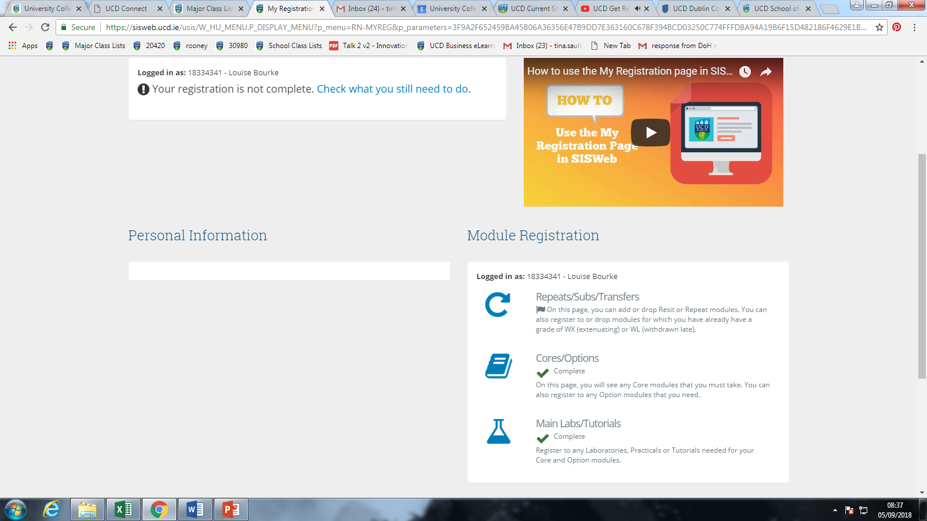
www.ucd.ie/students/registration

Slide 8
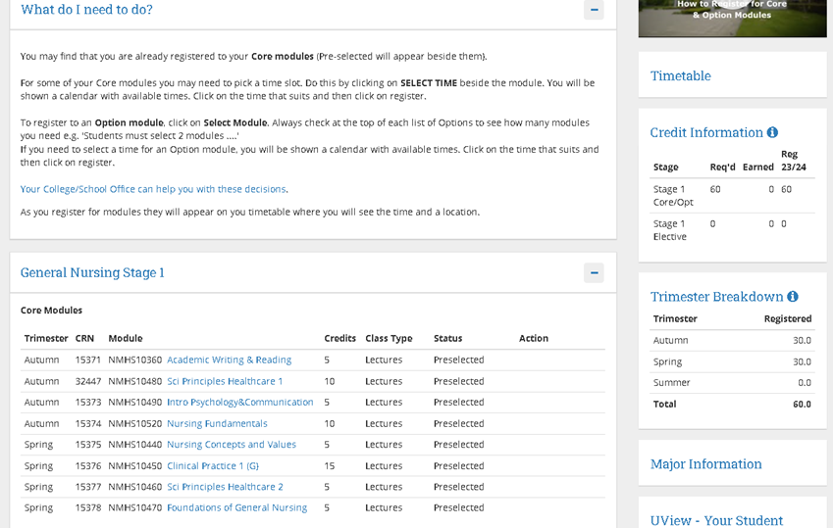
www.ucd.ie/students/registration

Slide 9
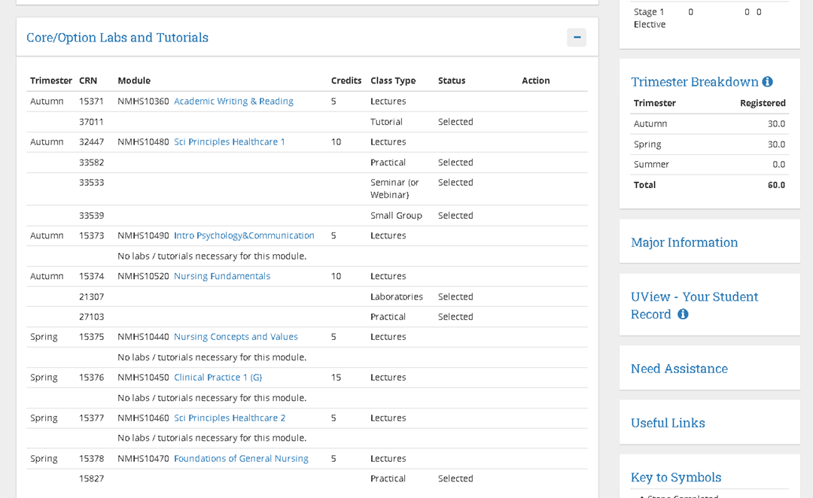
www.ucd.ie/students/registration

Slide 10
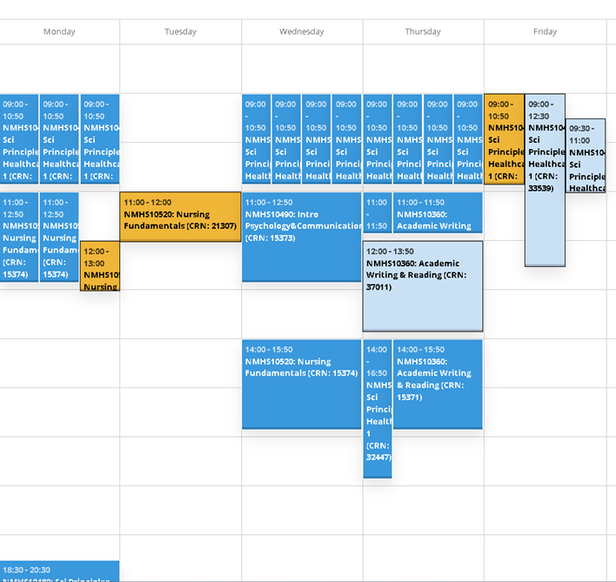

Slide 11
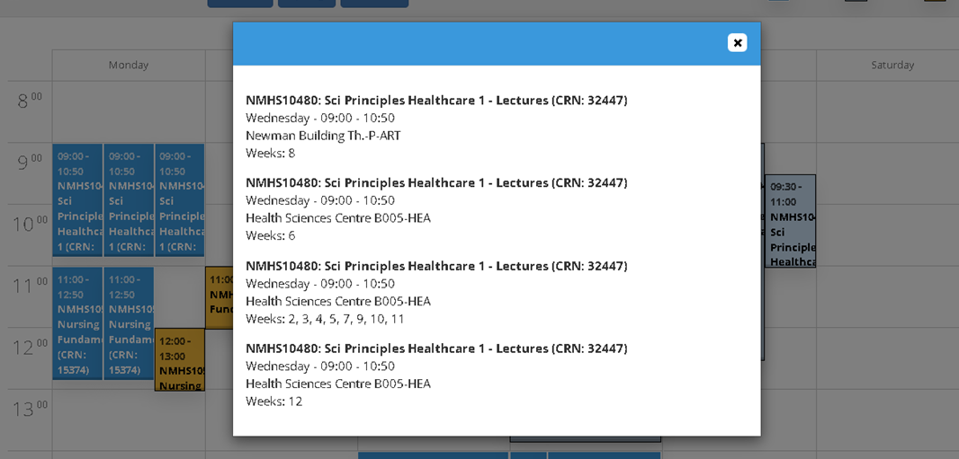

Slide 12

Student Information System SISWeb
Registration
Student Records
Update Personal Information
Certificate of Attendance
More information at www.ucd.ie/students/studentdesk/

Slide 13

UCD Student Desk
Fees
Official Documents - Certs of Attendance
Form Stamping
Registration
Exam Information
More information at www.ucd.ie/students/studentdesk/

Slide 14

UCARD
Your campus smartcard
It’s your official ID – you must have it with you for your exams
You can use in UCD shops, restaurants, access to Library, Residences, Sport & Fitness
Pre-requisites for UCARD:
All students must complete the UCard prerequisites before a UCard can be printed.
Only students that have completed prerequisites and received email with a confirmed collection time should attend the UCARD collection on Thursday 04 September 2025
More information at www.ucd.ie/ucard

Slide 15

Orientation Timetable Thursday 04 September 2025 and Checklist
See Orientation checklist for information on
- Clinical Skills Items, Polo Shirt, Workbook and McGraw-Hill
Uniforms Fitting for some student groups Orientation Timetable Day 2

Slide 16

Parking in UCD
Permits required
Parking permits will be charged at €50.00 per trimester
Visitor Hourly Paid Parking Areas €1.00 per hour (08:00 – 17:00 Monday – Friday 52 weeks a year)
More information at ucdestates.ie/commuting

Slide 17

Social Events Schedule

Slide 18


News, events and updates
‹#›
School website
School Orientation webpage
Twitter
Instagram
YouTube
www.ucd.ie/social-media

Slide 19
Questions and Answers?
‹#›

Slide 20
Policies and Regulations
Academic Regulations | Academic Regulations
Continuation - Academic Progress | https://www.ucd.ie/secca/continuation-academicprogress/
Late submission of Coursework | Late submission of coursework policy and form
Leave of Absence | Leave of absence policy
Extenuating Circumstances | Extenuating circumstances policy and guidelines
Recognition of Prior Learning | RPL Policy and Guides
https://www.nmhs.ucd.ie/current-students

